Slide 1

Module 8 A Cross-sectional study II
PHW 2710 L
Epidemiology III
Miryoung Lee
Notes:
Welcome back to Module 8. We will continue to review important information regarding the cross-sectional study design this week.

Slide 2
Learning objectives
Describe sources of bias in a cross-sectional study.
Describe how to handle confounding in a cross-sectional study – use of statistical programs
Describe external validity in a cross-sectional study.
Notes:
During this week, we will continue to review potential biases and confounding that can occur in a cross-sectional study. Then we will use statistical methodology to incorporate confounding using statistical programs. Also, we will review the generalizability issue that occurs in a cross-section study.

Slide 3
Cross-sectional study
Can combine a cross-sectional study with follow-up to create a cohort study.
Can conduct repeated cross-sectional studies to measure change in a population.
NHANES trend analysis of obesity
Can measure attitudes, beliefs, behaviors, personal or family history, genetic factors, existing or past health conditions, or anything else that does not require follow-up to assess.
Notes:
Cross-sectional studies are most familiar to us as surveys. In a cross-sectional study, people are studied at a “point” in time. Follow-up is not generally a part of the cross-sectional study, though sometimes a cross-sectional study serves as the baseline for a cohort study or intervention trial. Or often the investigators publish the information based on baseline data from a cohort study. Sometimes cross-sectional studies are carried out repeatedly in the same population(s), so that results can be compared across time and changes observed. As you already know, NHANES surveys are good examples and these survey are conducted in two year cycles nowadays. The most recent NHANE study was finished between 2017-2018. Some datasets are available on CDC website.
Cross-sectional studies measure prevalence of health conditions, exposures, and other characteristics of the population. They provide a “snapshot”. The cross-sectional design can be used to measure any factor that can be reported by respondents (or study participants) or assayed noninvasively and that does not require follow-up to assess. Cross-sectional studies or cross-sectional surveys are the source of most of what we know about the population other than vital statistics.

Slide 4
Part 1 - Bias
Notes:
Let’s review potential biases that can happen in cross-sectional studies.

Slide 5

Possible questions on bias in cross-sectional studies
Could selective survival explain findings?
Could selective recall explain findings?
Does a factor cause disease or does the disease cause the factor? (reverse causality)
Could treatment of disease or change in lifestyle in response to disease cause finding?
Notes:
Many questions can be asked when you read an article that utilize a cross-sectional study. For example, you can ask whether selective survival can explain the authors’ findings presented in the study.

Slide 6
Selection bias in cross-sectional studies
Length time bias
Non-response bias when participants differ from non-participants
Sedgwick P. Non-response bias versus response bias. BMJ 2014;348:g2573
Healthy volunteer bias when participants are healthier than the general or target population
Notes:
In module 3, we reviewed most common biases the you can identify in observational studies.
Selection bias is a general term to describe a category of biases that result in a sample that is systematically different from the target population that the authors are intended to represent. If the study is based on population based surveys, such as NHANES or BRFSS, population based random sampling can minimized selection bias. However, even though you are using the population based sampling, the sample participants are recruited over random digit dialing for example, the study still suffer from non-response bias. Non-response bias is a little bit different in that non-participants are different from participants. Non-response is a particular problem affecting cross-sectional studies and can result in bias of the measures of outcome. This is a particular problem for questionnaire surveys where not all people who are approached will agree to participant in. However it would be difficult to identify any differences in characteristics between respondents and non-respondents because of lack of information.
Please read the referred article by Dr. Sedgwick that explains the difference between the non-response bias and the response bias using an example.
On the other hand, the sampling may be prone to volunteer bias, where participants are systematically or generally healthier than the general or target population.
Reference:
Sedgwick P. Non-response bias versus response bias. BMI 2014;348:g2573
Sedgwick P, Bias in observational study designs: cross-sectional studies. BMJ 2015; 350:h1286. PMID: 25747413

Slide 7
Prevalence-Incidence Bias (Neyman bias)
Prevalence-incidence bias (i.e., Neyman bias or selective survival bias)
Duration bias
a type of selection bias that occurs when the duration of the disease after onset is different between exposed and unexposed persons
May operate in either direction
Point complement ratio bias
Tends to underestimate the association for factors that increase the prevalence of disease (outcome)
Tends to overestimate the association for factors that decrease the prevalence of disease (outcome)
Notes:
In Module 7, we already reviewed the component of prevalence-incidence bias and its two components: duration bias and point complement ratio bias.
Prevalence-Incidence Bias can occur when “a series of survivors is selected if the exposure is related to prognostic factors, or the exposure itself is a prognostic determinant, the sample of cases offers a distorted frequency of the exposure”, according to Neyman. This bias occurs in case-control studies and cross-sectional studies.
This bias is more prevalent when the risk factor or exposure influences mortality from the disease or outcomes being studied (Hill et al. 2003). Selected study population over-represents disease cases of long duration, and under-represents disease cases of short duration. Excluding patients who have died will make the disease or outcome appears to be less severe. Excluding patients who have recovered will make the disease seems to be more severe. The greater the time between exposure and investigation means more likelihood of individuals dying or recovering from the disease and therefore being excluded from the analysis, and this bias is more likely to impact long-lasting diseases than short-acting conditions.
Reference: Neyman J. Statistics: servant of all sciences. Science 1955;122:401-6
Hill G et al., Neyman’s bias re-visited J Clin Epidemiol 2003;56:293-6

Slide 8
Information bias in cross-sectional studies
Recall bias
Temporal ambiguity - Usually we cannot establish the temporal sequence between exposure and outcome in cross-sectional studies
Ascertainment bias or response bias
Notes:
Information bias occurs during data collection. Selective recall or lack of information on past exposure can produce information bias (best to study factors that do not change over time).
Recall bias can occur if the study asks participants about past exposures and it results in misclassification. While recall bias is more common in case-control studies, it can occur in cross-sectional studies. Temporal ambiguity occurs when the temporal sequence between exposure and outcome cannot be established. It is common in cross-sectional studies. Ascertainment bias or response bias during data collection can occur. For example, the information obtained from the respondents or participants on their BMI, sexual behavior or adverse health habits (drug use) may be systematically different from their actual BMI. For example, Ward et al (2016) compared the obesity estimates from the Behavioral Risk Factor Surveillance System (BRFSS) 2013 survey and national estimates from NHANES,

Slide 9
Obesity rate based on self-reported vs objectively measured weight and height
Ward ZJ et al. PLoS One 2016; 11(3): e0150735. PMC478299
Notes:
These two slides will give us some ideas of how misclassification (information bias) may result in incorrect assessment of a measure of disease frequency or a measure of association. The example is based on the influence of bias in estimating the state-level obesity prevalence rates. The most recognizing biases in obesity research relying on self-reported weight and height are recall bias and response bias. Particularly, in cross-sectional surveys and case-control studies, differential perceptions of the possible unhealthy effects of fatness could result in response bias. In-person interview studies reported that participants underestimate their weight (~1 kg), and overestimate their height by about 1 cm.
Obesity rates at the national level and trends are reported based on NHANES. However, there are some interesting differences noted by many researchers. According to NHANES data based on objectively measured weight/height data, national level of adulthood obesity (BMI >= 30 kg/m2) is about 34% while obesity prevalence based on self-reported data from 2013 Behavioral Risk Factor Surveillance System (BRFSS, N = 386,795) was about 29%.
Reference: Ward ZJ et al., Redrawing the US obesity Landscape: Bias-corrected estimates of state-specific adult obesity prevalence. PLoS One 2016; 11(3): e0150735. PMC4782996

Slide 10
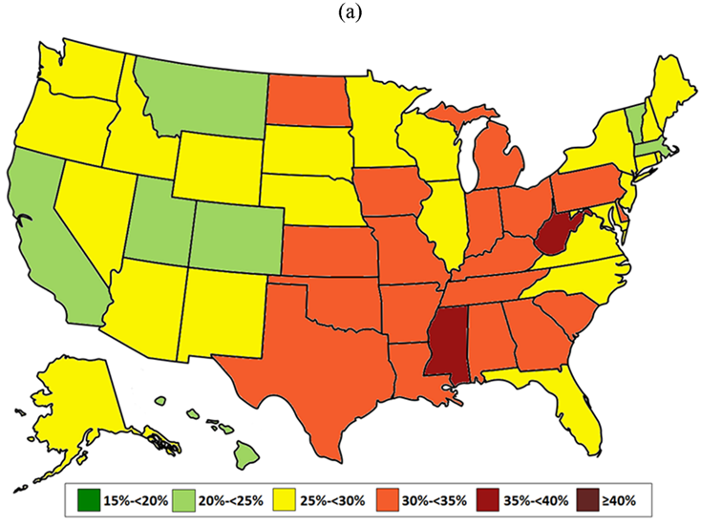
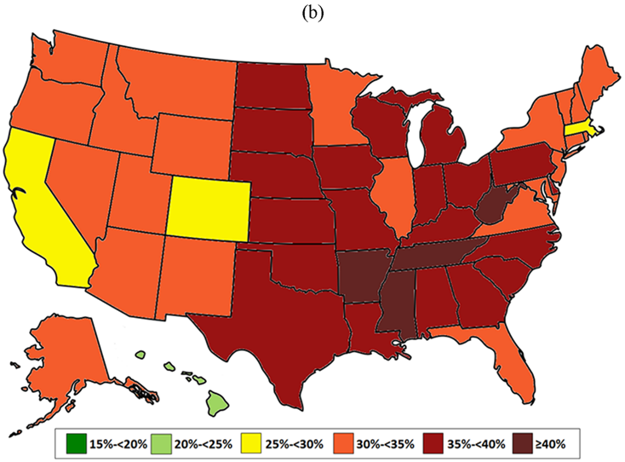
Impact of self-reported weight/height on state-specific obesity prevalence rates
2013 Behavioral Risk Factor Surveillance System (BRFSS, N = 386,795) on Adult Obesity in 2013
https://www.cdc.gov/obesity/data/prevalence-maps.html
Ward ZJ et al. PLoS One 2016; 11(3): e0150735. PMC478299
Notes:
The sample size in NHANES is too small in order to estimate state-level obesity prevalence. Thus, the famous state-level obesity maps shown here have been generated by the CDC, based on BRFSS data. Self reported height and weight data from the telephone-administered BRFSS are used to derive state-level obesity rates. The left figure (a) illustrate state-level obesity rates in 2013.
In an interesting paper, Ward et al. have shown how the seemingly small individual level biases can result in large differences in state-level estimates of obesity rates. In figure b, state-level obesity prevalence rates in 2013 were recalculated based on bias-corrected obesity prevalence data using matching NHANES information and some statistical methods. As you can see, the magnitude of state-level obesity rates is changed quite a bit before and after adjusting for bias related to self-reported data. For example, self-reported obesity in adults was 30.9%% in Texas. After the authors corrected bias, the obesity rate in Texas was up to 35.4%. In South Dakota, the obesity rate was 29.9% and jumped to 35.3% after the correction. Imagine that the policy makers and officials in these states try to plan programs and economic resources for obesity prevention and intervention. It would be necessary to use accurate state-specific obesity estimates.
In general, the authors reported that self-reported BRFSS data underestimated prevalence of obesity by 16% in comparison to NHANES.
Reference: Ward ZJ et al., Redrawing the US obesity Landscape: Bias-corrected estimates of state-specific adult obesity prevalence. PLoS One 2016; 11(3): e0150735. PMC4782996

Slide 11
Confounding in a cross-sectional study
Module 4-Confounding & DAG
Exposure and outcome at the same time
Estimate the prevalence of outcome & exposure
Calculate prevalence OR
Participants recruited based on inclusion and exclusion criteria
Confounding at the same time
Notes:
Let’s briefly think of what we learned in Module 4.

Slide 12

Approaches to control ‘confounding’
Study design and data collection
Randomization (in experimental studies)
Restriction/limitation
Matching
Data analysis
Stratification
Mantel-Haenszel estimation of POR.
Adjustment in modeling (more common ways in modern epidemiology)
Multiple regression modeling
Propensity score (more recent)
Notes:
There are several approaches to control confounding in the design stage or analysis stage of a study as we learned. The limitation of a cross-sectional study design prohibit the investigators to control confounding during the design stage of the study. It is possible to restrict study population or sample based on confounding factors. However, restriction may potentially limit the generalizability of study findings. Important sources of confounding can be determined before the study begins. However, this often is not the case in general.
While the investigators conduct the statistical analysis, confounding can be adjusted by stratification and adjustment of confounders in modeling most often in cross-sectional studies. Adjustment in regression models is more common way in modern epidemiology due to its advantages in which we can incorporate various types (categorical or continuous) or as many as confounding factors at the same time if necessary.

Slide 13
Confounding in current smoking and hypertension Framingham Heart Study example
There is one backdoor path from Smoking to Hypertension
: Smoking (E) ← Age (A) → BMI (B) →Hypertension (O)
Three sets of variables that are sufficient to control for confounding
{Age}, {BMI} or {Age, BMI}
Age (A)
BMI (B)
Current Smoking (E)
Hypertension (O)
Notes:
Let’s think of our example, Framingham Heart Study baseline example, from the Module 7. Assume that there is a causal relationships between current smoking and hypertension.
The relationship between smoking and hypertension was negative meaning that current smokers reported less likely to have hypertension (yes) than non-current smokers do in this modified dataset example. Potential confounders in this example can be Age and BMI from literature and these two variables WERE measured at the time of smoking and hypertension assessment. Both age and BMI are continuous variables while current smoking and hypertension have two answers (yes or no, binary variables0.
Before we move onto next step, let’s take look at this DAG first to describe possible causal relationship between smoking and hypertension. In this particular EXAMPLE, we can say that there is one backdoor path from Exposure to Outcome. If this is true DAG, we can control for age alone, BMI alone, or both Age and BMI to satisfy the backdoor path criterion. Usually, investigators choose the smaller set of confounder in the analysis. However, considering that this DAG is a really simplified version of causal relationships between smoking and hypertension with many unaccounted confouders, we will include both age and BMI in the analysis.

Slide 14
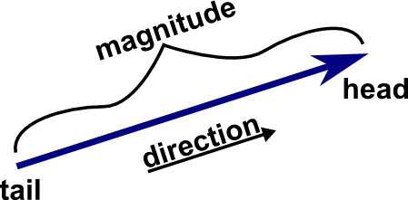
Identifying the presence of confounding
Knowledge based – investigators will determine whether a potential confounding variable is associated with the exposure of interest and whether it is associated with the outcome of interest.
A simple rule of thumb- if the adjusted measure of association changes about 10% or more after adjusting for a confounder(s) from the crude measure of association, then confounding may be present
Notes:
Of course, we will need to think of the causal relationship between the exposure and outcome first. In Module 3, however, we learned that 1) there is no agreed-upon statistical test to identify confounder, 2) there is a rule of thumb that many epidemiologists are using: if the difference between crude estimate and adjusted estimate is 10% or more, then confounding is present under the DAG. If it is less than 10%, then there was little, if any, confounding. However, the presence of confounding is based on knowledge. If there is a clinically meaningful relationship between a potential confounder and the risk factor, and between a potential confounder and the outcome variable, the variable should be regarded as a confounder regardless of the rule of thumb (10% or less).

Slide 15
Part 2 - Data Analysis
Notes:
In Module 7, we briefly reviewed how to calculate prevalence OR and prevalence ratio (PR) using statistical programs such as STATA using the modified the Framingham Heart Study baseline data. In this module, we will consider to adjust for both confounding factors, age and body mass index (BMI) related to prevalence of hypertension and smoking. Let’s adjust confounding factors in the analysis.

Slide 16
Regression analysis methods based on a dependent variable (outcome) type
Binary outcome (Disease: yes or no) → Binary logistic regression
Ordinal outcome (multiple outcome levels) → Ordinal logistic regression
Obesity, overweight, and normal (reference) based on body mass index categories
Likert scale type outcome (e.g., poor to excellent health, disagree to agree)
Nominal outcome (multiple outcome levels) → multinomial logistic regression
Continuous outcome (normally distributed)→ Linear regression
- Systolic blood pressure or glucose levels
Notes:
In Epidemiology III, I do not intend to go over details of statistical assumptions, statistical methods and diagnostics for regression methods. I hope you already have some important information from your Biostatistics classes. In summary, just to look at variable types of outcome (categorical or continuous), we can first think of a couple of regression analysis approaches. A lot of studies dealing with a disease (yes or no), we can use binary logistic regression models similar to contingency table analysis (2 by 2 table analysis). In FHS example, we have a hypertension status as a binary variable (yes or no) and we plan to adjust for two confounders (age, BMI). Then binary logistic regression analysis can be conducted. What if we have systolic blood pressure (SBP) or diastolic blood pressure (DBP) as outcome (a continuous variable) instead of hypertension status? Then we can employ the linear regression approach to examine the relationship between smoking and SBP and to adjust for age and BMI.

Slide 17
Logistic regression for POR
Outcome (hypertension at baseline or exam 1); prevhyp1
Exposure (current smoking at baseline or exam 1): cursmoke1
Confounders: Age1, BMI1
Unadjusted→ logistic prevhyp1 cursmoke1
Notes:
These two slides include the replicated results using STATA. You can add variables to adjust for confounding effects in a multiple binary logistic regression analysis. The crude OR between current smoke (yes vs no) and hypertension (yes vs. no) is 0.6291. As we interpreted before, the current smokers have the less odds of having hypertension than the non-smokers.
Based on statistical analysis on testing the regression coefficient (not shown, beta = -0.463), the relationship between current smoking and hypertension is statistically significant at significance level of 0.05.
The 95%CI does not include 1 and it corroborate the statistical testing results

Slide 18
Adjusted logistic regression
Adjusted→ logistic prevhyp1 cursmoke1 age1 bmi1
Adjusted POR: 0.9897
Notes:
In this example, we adjusted both age and BMI in the model. The beta coefficient for current smoking variable changed from -0.463 to -0.010, and the statistical testing revealed that there is no statistical association in adjusted model.
As you already knew, odds ratio is calculated as exponential of -0.0103774, which is equal to 0.9897. Thus, OR between current smoking and hypertension is estimated as 0.9897 while adjusting for age and BMI in the model.

Slide 19
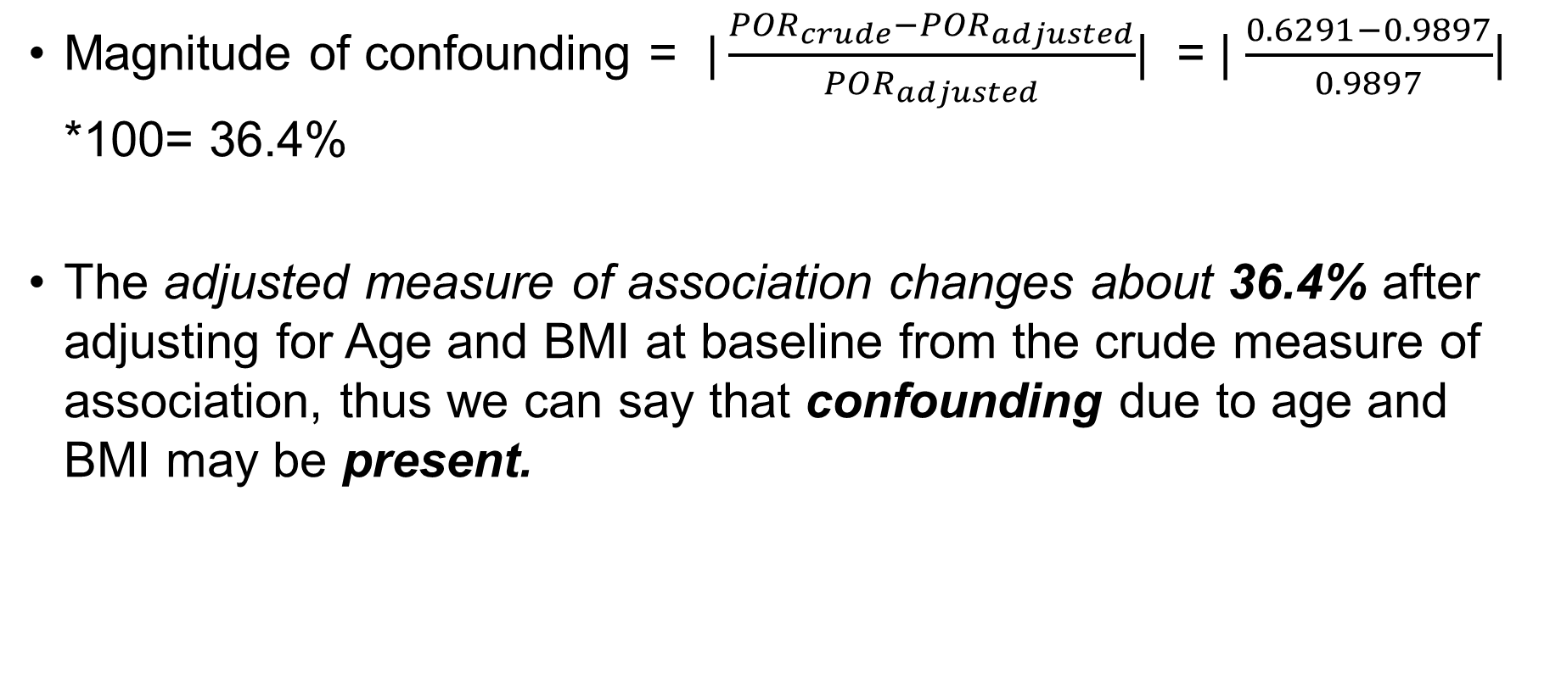
Confounding effect?
Magnitude of confounding = $|\frac{{POR}_{crude}−{POR}_{adjusted}}{{POR}_{adjusted}}$| = | $\frac{0.6291−0.9897}{0.9897}$| *100= 36.4%
The adjusted measure of association changes about 36.4% after adjusting for Age and BMI at baseline from the crude measure of association, thus we can say that confounding due to age and BMI may be present.
Notes:
Using the equation to get the magnitude of confounding on slide 14, The adjusted measure of association changes about 36.4% after adjusting for Age and BMI at baseline from the crude measure of association, thus we can say that confounding due to age and BMI is present.

Slide 20
Types of confounding
Positive confounding – overestimation of the effect or true association or when the observed association is biased away from the null (but same direction)
Negative confounding – underestimation of the effect or true association or when the observed association is biased toward the null (but same direction)
Qualitative confounding – adjustment of confounding results in the change of direction in relationship between exposure and outcome
Crude POR = 0.6291 vs. Adjusted POR = 0.9897
Notes:
As you recall, there are three types of confounding. You all did excellent jobs calculating the magnitude of confounding and identifying the type of confounding in Mid-term exam. Can you tell, in this example, what type of confounding exists?
As you answered, the positive confounding is present.

Slide 21
Part 3 - Review of a published cross-sectional study STrengthening the Reporting of OBservational studies in Epidemiology (STROBE)
Notes:
Let’s switch gears a little to talk about how to review a published cross-section study using the guidelines for the publication of cross-sectional studies.
STROBE is abbreviation for ‘STrengthening the Reporting of OBservational studies in Epidemiology’. The STROBE is “an international, collaborative initiative of methodologists, statisticians, researchers and journal editors involved in the conduct and dissemination of observational studies” (cross-sectional studies, case-control studies, cohort studies) according to its website.

Slide 22
STROBE statement checklists
Proposed 22 items
Clearly state study objectives and hypotheses
Include information on student design and study setting
Clearly define exposures and outcomes
Specify inclusion and exclusion criteria for subjects
Provide unadjusted estimates and confounder-adjusted point estimates and precision (e.g., confidence interval)
Discuss limitations of the study.
https://www.strobe-statement.org/fileadmin/Strobe/uploads/checklists/STROBE_checklist_v4_cross-sectional.pdf
Notes:
The slide includes a couple of items from STROBE checklists for reporting cross sectional studies.
22 items including sub-items are proposed as checklists. For example, it guides the authors to discuss limitations of the study and to consider sources of potential bias and its influence on study results. It also encourages the authors to discuss the generalizability or external validity of the study results.

Slide 23

Example: Echo-SoL
Cardio structure and function with and without metabolic syndrome: the Echocardiographic study of Latinos (Echo-SoL) (Burroughs Peña et al., 2018)
Hypothesis: metabolic syndrome (exposure) is associated with adverse changes in cardiac structure and function (outcome) in Echo-Sol study participants
Study sample: A cross-sectional sample of 1824 participants who are part of the HCHS/SOL in 2011-2014
Inclusion for Echo-SoL: Participants who are age >=45 years, self-reported Hispanic background, enrolled < 36 months from the baseline parent SOL visit.
Exclusion for the analysis: Participants who are diabetics or had history of coronary artery disease and aortic or valve disease.
Notes:
Let’s look at one example. Burroughs Pena et al., published a cross-sectional study results on examining the relationships between metabolic syndrome and adverse outcomes in cardiac structure and function measured using Echocardiogram. As listed here, the study sample, according to the authors, are selected from a populated-based longitudinal cohort study of 16415 of self-identified Hispanic Latinos (aged between 18-74 years of age). The study sample included in the study was recruited from “a stratified sampling process representative of the parent study”. The authors included participants who are aged over 45 years old etc.
For example, it guides the authors to discuss limitations of the study and to consider sources of potential bias and its influence on study results. It also encourages the authors to discuss the generalizability or external validity of the study results.
Reference: Burroughs Peña M et al., Cardio structure and function with and without metabolic syndrome: the Echocardiographic study of Latinos (Echo-SoL) . BMJ Open Diabetes Res Care 2018;6(1):e000484. PMC6091897

Slide 24
Echo-SoL – Limitation by the Authors
1) “it is a cross-sectional, observational study; therefore, determination of causality cannot be made”
2) “we are unable to adjust for BMI in the linear regression analyses because BMI is highly collinear with waist circumference, which is a component of the definition of metabolic syndrome.”
3) while this study is one of the largest studies … any population, the sample size is modest; thus, we are unable to perform stratified analyses by national origin … Hispanic/Latinos → Effect modification by ethnic background was not performed.
4) Within our sample, individuals with metabolic syndrome were disproportionately Cuban or Puerto Rican and lived in Miami. Thus, it would be interesting to compare cardiac structure and function in Cubans and Puerto Ricans with metabolic syndrome to other Hispanic/Latino groups → Generalizability of study findings may be limited.
Notes:
Here are some limitations mentioned by the Authors. I want you to pay attention to the last part of limitation.

Slide 25

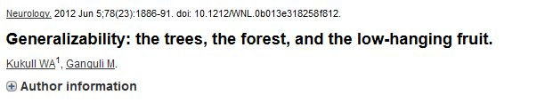
External validity
Generalizability
Population-based surveys
Estimation of the prevalence in clinic based studies
Changes in prevalence in many cross-sectional studies
Not so much problem in cross-sectional population based surveys (based on representative samples of entire population)
Problematic in cross-sectional studies of convenient samples
Notes:
In a lot of cross-sectional studies, authors stated that “This study sample is not representative of the population of interest” or “Our results are not generalizable…” as Kukull and Ganguli stated. An interesting article by Kukull and Ganguli is one of your reading materials. External validity conveys the meaning of generalization of the results observed in one population to others. There is not external validity without internal validity, but the presence of the interval validity does not guarantee the external validity. Population based surveys may be less subject to external validity problem. However, it may be good to start to reflect what “generalization” mean by before we continue on other observational studies.

Slide 26

In Summary…
In a cross-sectional study,
Measurement of the outcome and the exposures in the study participants occurs at the same time.
Participants are selected based on the inclusion and exclusion criteria set.
The prevalence ratio or prevalence OR can be measured.
The study can be conducted relatively faster and inexpensive.
The study, however, is difficult to derive causal-relationships and may suffer from various types of biases.
Notes:
In a cross-sectional study, the investigator measures the outcome and the exposures in the study participants at the same time. Unlike in case–control studies in which study participants selected based on the outcome status, or cohort studies in which participants selected based on the exposure status), the participants in a cross-sectional study are just selected based on the inclusion and exclusion criteria set for the study. We can measure the prevalence of disease or calculate the OR as a measure of association. These studies are conducted relatively faster and are inexpensive. However, due to the nature of study design, in general, it is difficult to derive causal relationships from cross-sectional analysis.

Slide 27

Acknowledgements
This presentation includes material/examples/slides from:
Szklo & Nieto, Epidemiology: Beyond the Basics 4th Edition
Celentano & Szklo, Gordis Epidemiology, 6th Edition
Dr. Elaine Symanski (Fall 2018, Epidemiology III)
Notes:
As usual, we will end this lecture with acknowledgments for the sources or people that helped in making this lecture.

